Slide 1

Lession 2
Module Structure, Models & Fields, Data Introduction

Slide 2
Models Structure
PATERS

Slide 3


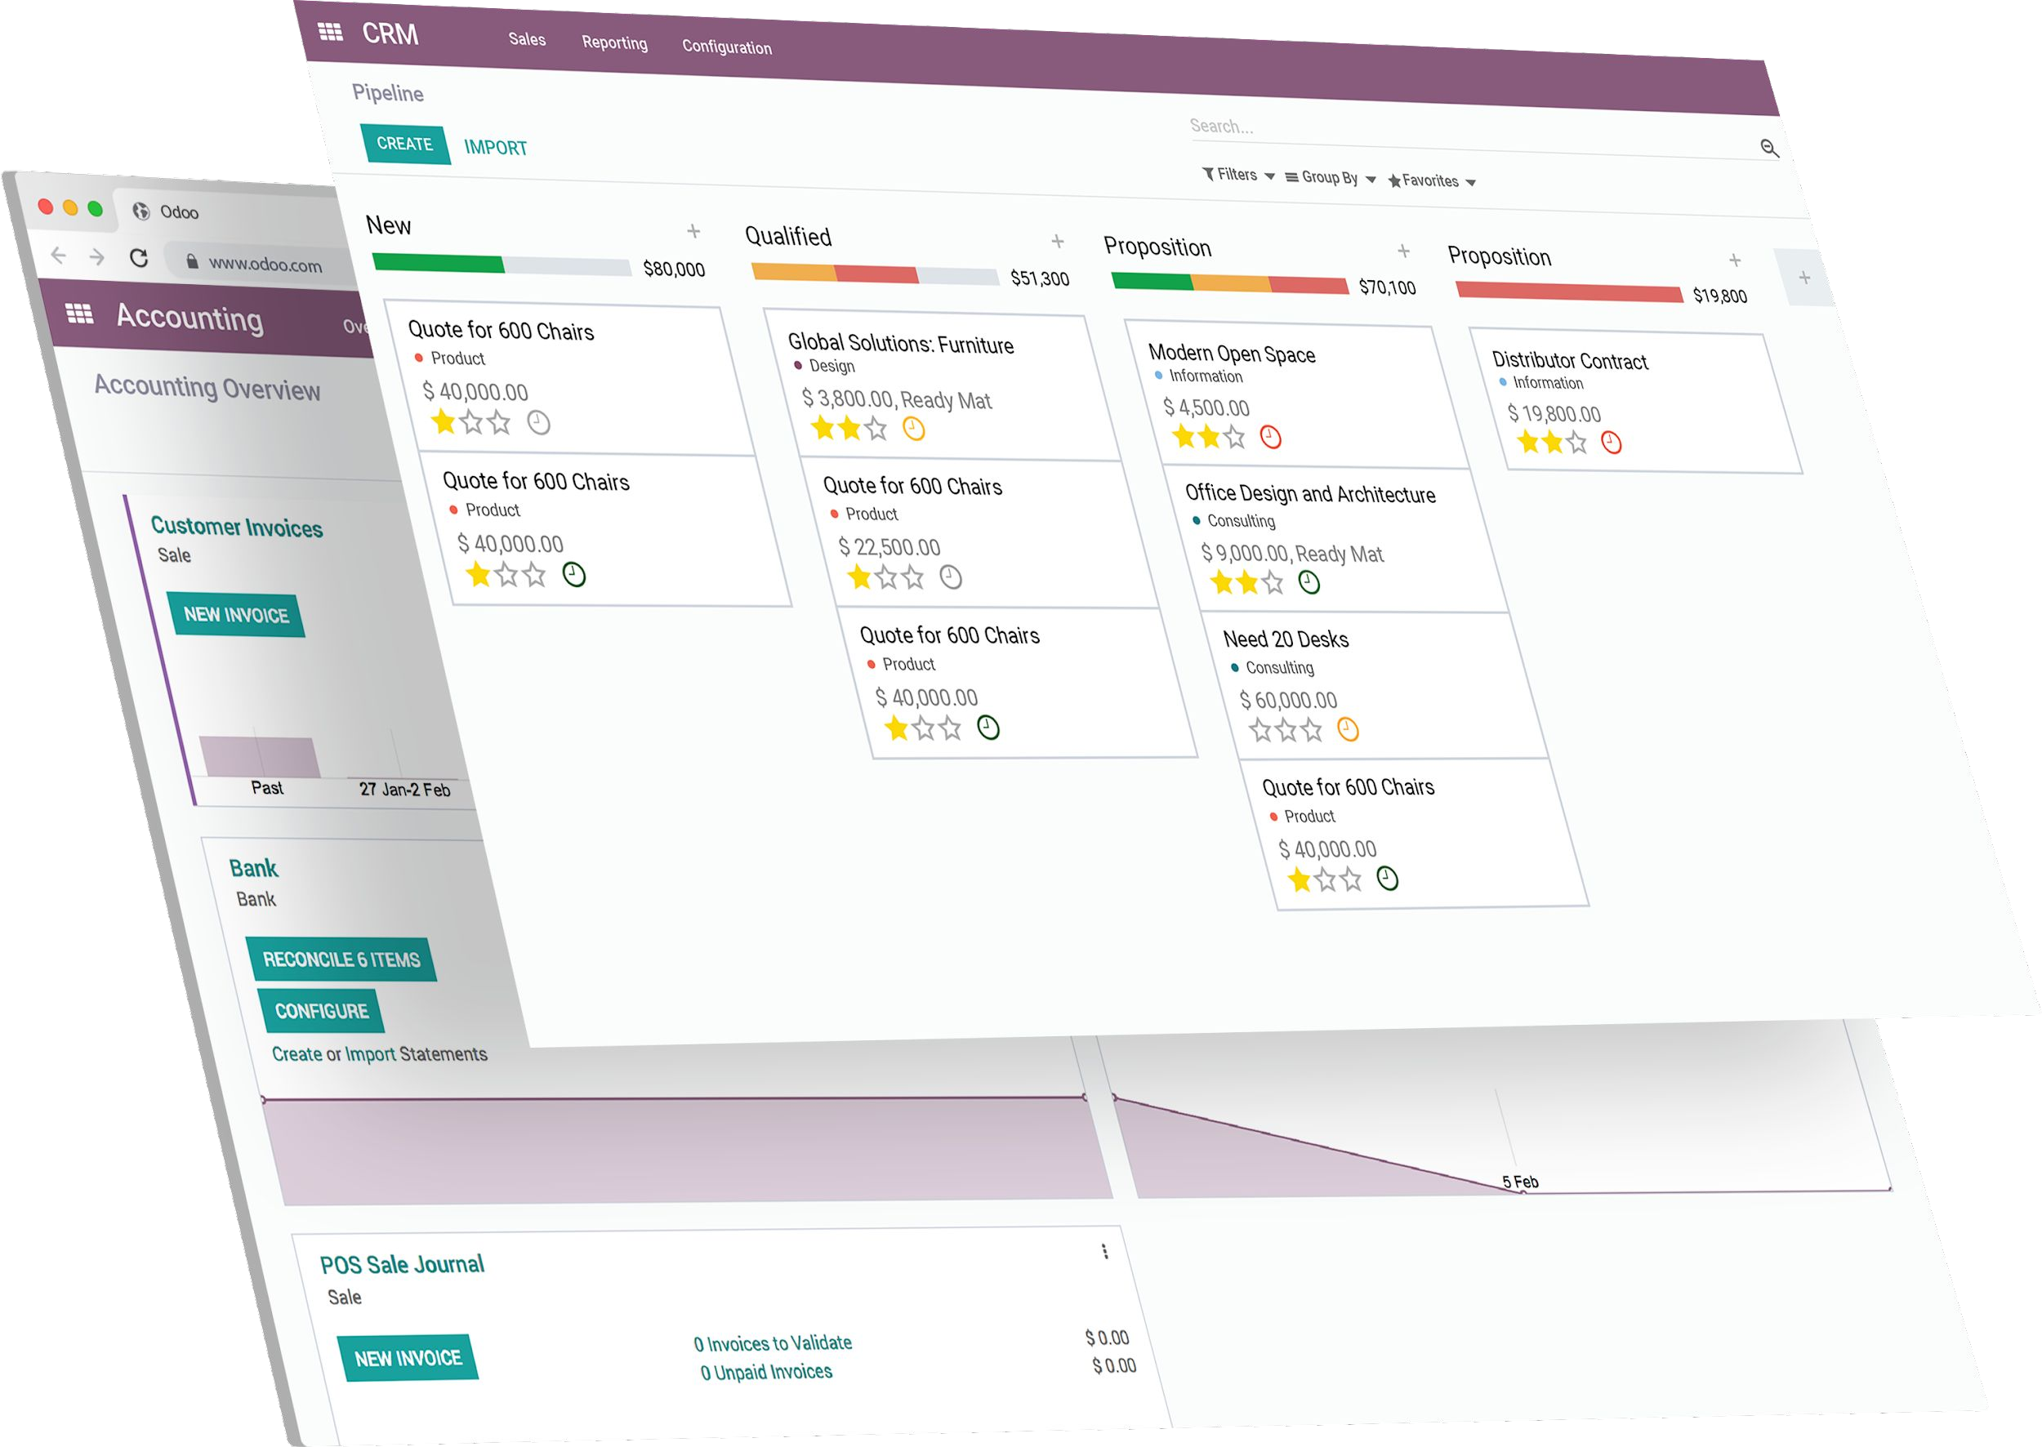










What’s a module
Odoo = modular ERP
1 module = 1 set of features
Adaptable
Install standard features to meet your needs
Customizable
Create new modules or extend existing ones easily
Developer Mode

Slide 4





Module composition
project_directory/
│
├─ module_a/
│ ├─ controllers/
│ │ ├─ init .py
│ │ └─ controller.py
│ ├─ data/
│
│
│
│
│
│
│
│
│
│
│
│
Module = Directory
Models (Business Objects)
Declared as Python classes using init .py file. Models definition for the data structure and the business logic of the module
Views
Definition of the user interface to display information on screen and interact with end users
Data Files
Data to load at the installation of the module; may contain configuration data, security rules, demo data, etc
│ └─ data.xml
├─ models/
│ ├─ init .py
│ └─ model.py
├─ security/
│ └─ ir.model.access.csv
├─ views/
│ ├─ templates.xml
│ └─ views.xml
├─ init .py
└─ manifest .py
└─ module_b/
├─ …
└─ …

Slide 5



Manifest structure
name (str, required)
version (str)
description (str)
author (str)
website (str)
license (str, defaults: LGPL-3)
category (str, default: Uncategorized)
depends (list(str))
Odoo modules which must be loaded before this one.
data (list(str))
List of paths of data files which must always be installed or updated with the module.
demo (list(str))
List of data files which are only installed or updated in demonstration mode.
auto_install (bool or list(str), default: False)
If True, this module will automatically be installed if all of its dependencies are installed.
external_dependencies (dict(key=list(str)))
A dictionary containing python and/or binary dependencies.
assets (dict) (v15+)
auto_install (boolean)
application (boolean)
…
__manifest__.py
{
"name": "Module Name",
"summary": """Small summary about the module""", "version": "1X.0.0.0.0",
"author": "My Company",
"website": "https://www.mycompany_web.com", "license": "XXXX-X",
"depends": ["module_a","module_b"], "data": [
"views/mymodule_view.xml",
],
"demo": [
"demo/demo_data.xml",
],
}

Slide 6
Licenses
2 types of available licences
Open source Odoo Proprietary
GPL-2
GPL-3
AGPL-3
LGPL-3
OEEL-1
OPL-1 -
- Odoo Enterprise Edition License v1.0 Odoo Proprietary License v1.0
CLICK HERE

Slide 7
Models & Fields
PATERS

Slide 8


Object-Relational Mapping
SQL table
Python Class
Model
CLICK HERE

Slide 9





Models
1. The model is defined in the file
module/models/model.py
model.py
from odoo import models
2. The file model.py is imported in
module/models/ init .py
class TestModel(models.Model):
_name = "test.model"
_description = "Test Model"
3. The folder models is imported in
module/ init .py
CLICK HERE
module/
│
├─ │ | models/ ├─ init .py | (2)
│ | └─ model.py | (1)
│ └─ | init .py | (3)

Slide 10




Fields
Define what the model can store and where it is stored.
from odoo import fields, models
Fields are defined as
attributes in the model.
class TestModel(models.Model):
_name = "test.model"
_description = "Test Model"
field_1 = fields.Boolean() field_2 = fields.Integer()

Slide 11
Fields
Two categories:
Simple fields are atomic values stored directly in the model's table
Relational fields are link between records (of the same or different models).
CLICK HERE

Slide 12


Simple ﬁelds
Boolean
- True / False
Char s Text
- character string
Selection
- list of string options
Float s Integer
- numbers
Date s Datetime
- dates
Binary
- to store files, …
HTML
- formatted text

Slide 13

Fields attributes
String
field name displayed in views
True or False, displays the field or not in the views
True or False, if true then field cannot be edited by user
True or False, if true then record cannot be saved in database with an empty/null value
- Sets value on the field automatically during record creation
Invisible
Readonly
Required
Default
…
info = fields.Char(string="Test", required=True, default="test")

Slide 14
Data Introduction
PARTNERS

Slide 15

Data types
Master Data
VS
Demo Data
CLICKHERE

Slide 16
Master Data
Essential for the module to work properly.
Technical : Views, actions, groups… (see next chapters)
Business : countries, currencies, units of measure, …
Loaded when you install/update the module
CLICK HERE

Slide 17

Demo Data
Used for testing or demonstration purposes
Help Sales to make quick demos.
Working data for Developers to test new features.
Testing that loading data doesn't raise an error.
Loaded when you start the server.
CLICK HERE

Slide 18

Data declaration
project_directory/
│
└─ module_a/
├─ data/
In the manifest of the module
│ └─ data.xml
├─ security/
│ └─ ir.model.access.csv
Located in different directories such as data, views, …
├─ views/
│ ├─ templates.xml
│ └─ views.xml
└─ manifest .py
Essentially XML files, but can also be CSV files or other types of files.
CLICK HERE

Slide 19



Exercise
1) Create a new module estate in the following folders
Lession2
New Module
$HOME/$USER/src/technical-training/estate
In your new module, add the init .py and the
manifest .py files.
In the manifest .py dictionary, define a name, a version and a license. Also, in the dependencies, specify for now the module base.
Use the application key to make your module an App.
Run the command line and check your new module appears in the applications list.

Slide 20
Exercise
Define the real estate properties model.
Lession2
New Module
1) In the estate module, add a new directory to store our models python files.
In this directory, create a new python file for the
estate_property table (don’t forget to add the init too).
When the files are created, add a minimum definition for the
estate.property model.
Add a _description to your model to get rid of one of the warnings.
Help: For now, just remember that in the future, we will try to have one model per file in order to keep the project as object-oriented and clean as possible.

Slide 21
Exercise
Add basic fields to the Real Estate Property table.
Field Type
name Char
description Text
postcode Char
date_availability Date
expected_price Float
selling_price Float
bedrooms Integer
living_area Integer
facades Integer
Lession2
New Module
Add Fields

Slide 22
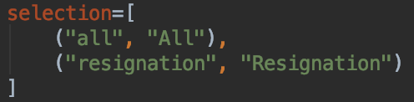
Exercise
Add basic fields to the Real Estate Property table.
Field Type
garage Boolean
garden Boolean
garden_area Integer
garden_orientation Selection
Lession2
New Module
Add Fields
Add Fields (2)
The garden_orientation field must have 4 possible values: ‘North’, ‘South’, ‘East’ and ‘West’.
The selection list is defined as a list of tuples, Ex:
CLICK HERE

Slide 23
Exercise
Set attributes for the following fields
Lession2
New Module
Add Fields
Add Fields (2)
Fields attributes
Field
Attribute
name
required
expected_price
required

Slide 24
Exercise
Create one demo data in previously created model.
Lession2
New Module
Add Fields
Add Fields (2)
Fields attributes
New model data
1) In the estate module, add a new directory to store our demo data files.
In this directory, create a new xml file for the demo data demo.xml (don’t forget to add the “demo” key in the manifest manifest too).
In the xml, add one record for the estate.property model. Don’t forget to add at least all the required fields in the latter.
CLICK HERE

Slide 25
Exercise
Create a new group of admin users for our model.
Lession2
New Module
Add Fields
Add Fields (2)
Fields attributes
New model data
Groups
1) In the estate module, add a new directory to store our security
data files.
2) In this directory, create a new xml file for the groups
res_groups.xml (don’t forget to add the “data” key in the manifest
manifest too).
3) In the xml, add one record for the res.groups model.
The id of this group will be estate_admin as it will be used to set the administrators of our model.
The only required field for this model is the name (e.g. Estate Manager).

